Slide 1

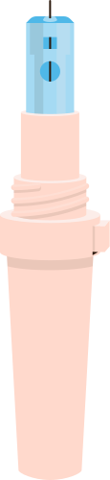
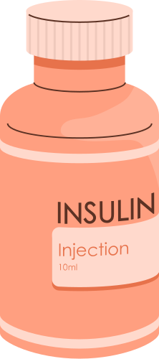
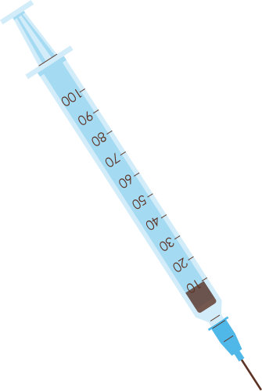


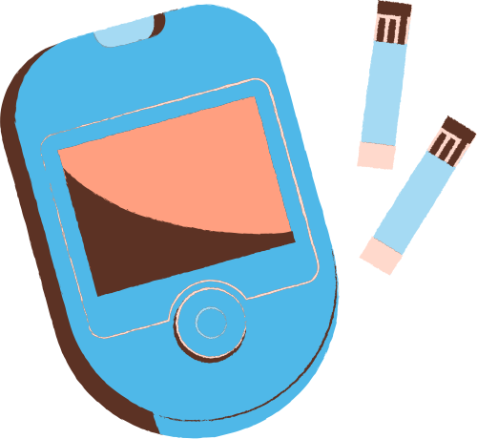
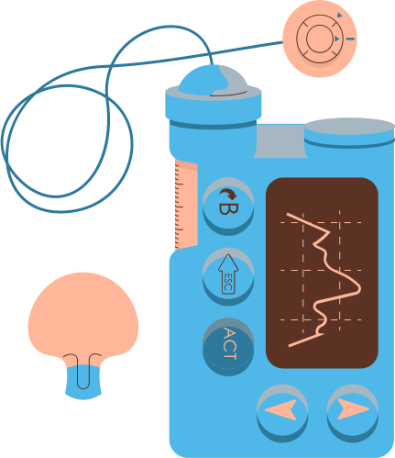
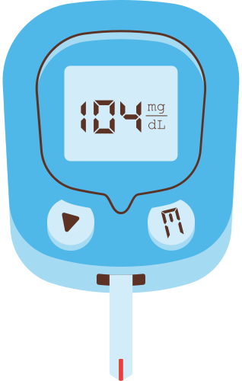

DIABETES : THE UNENDING PANDEMIC
Group 3 :
Khoo Qian Yee
Tang Ruixuan
Tan Chong Yao

Slide 2

DATA ANALYSIS
PIPELINE
Introduction
Motivation, Problem Definition, Dataset Used
Exploratory Analysis
Data Insights
Data Curation
Machine Learning
Decision Tree, Logistic Regression, Gaussian Naive Bayes, K-Means
Conclusion
Outcome
Concluding Insights

Slide 3

INTRODUCTION

Slide 4
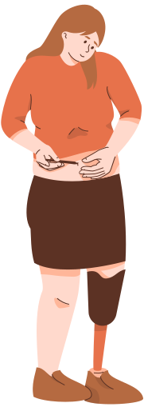
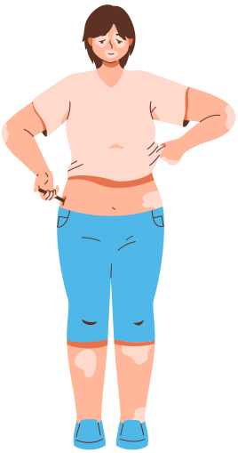
OUR MOTIVATION
Diabetes can be fatal and lead to one being disabled when left untreated.
Rate of diabetes increases with an alarming rate due to sedentary lifestyle of people
Treating early can help patients minimise the damage before it is too late

Slide 5

PROBLEM STATEMENT
How do we determine early diabetes detection using numerous attributes given?

Slide 6
PROBLEM STATEMENT
How do we determine early diabetes detection using numerous attributes given?
What attributes are necessary in early detection of diabetes?
Which model is the best in predicting it?

Slide 7

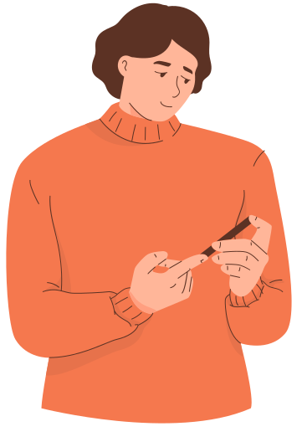
DATA COLLECTION
Dataset used : Pima Indians Diabetes Database taken from Kaggle

Slide 8

DATA COLLECTION
Made available by “National Institute of Diabetes and Digestive and Kidney Diseases”

Slide 9
INSIDE THE DATA
Belong to the Pima Indian heritage, a subgroup of Native Americans.
Every Individuals in the dataset are females
All of them are aged 21 and above.

Slide 10
EXPLORATORY ANALYSIS

Slide 11
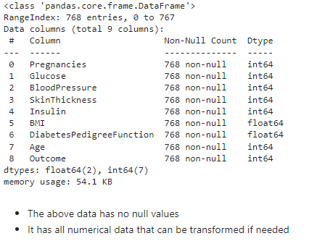

SUMMARY OF THE DATASET
2 types of data :
Both are numerical, either integer or float
Only 2 variables are type float 64
Contains 768 entries

Slide 12
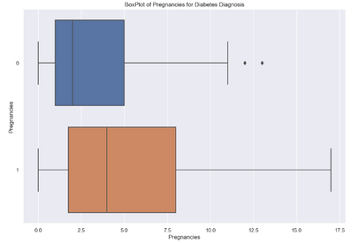
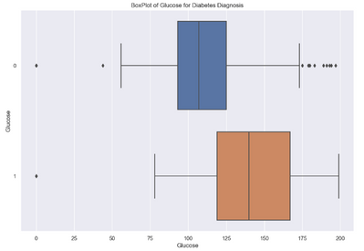
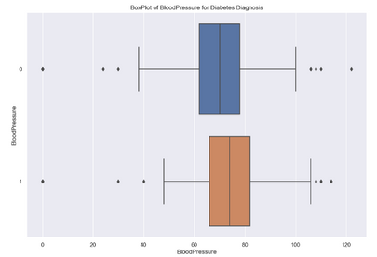
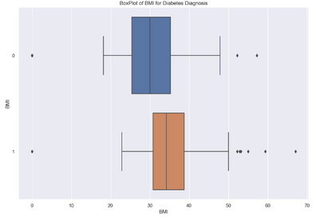
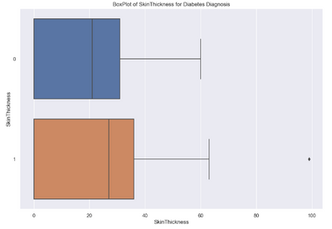
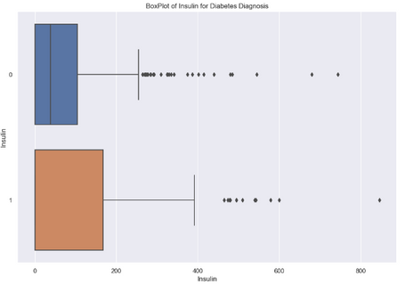
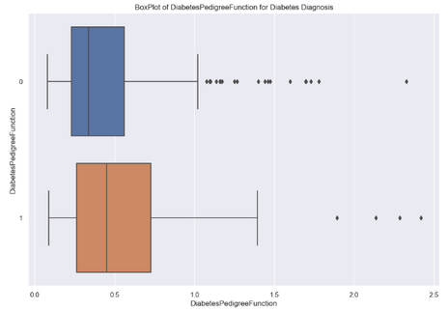
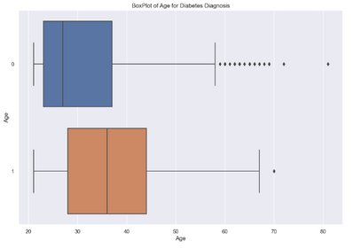
DATA INSIGHTS
Separation of two categories (Diabetes vs No Diabetes)
Data of those with diabetes have a higher median in all variables compared to those that don’t.

Slide 13
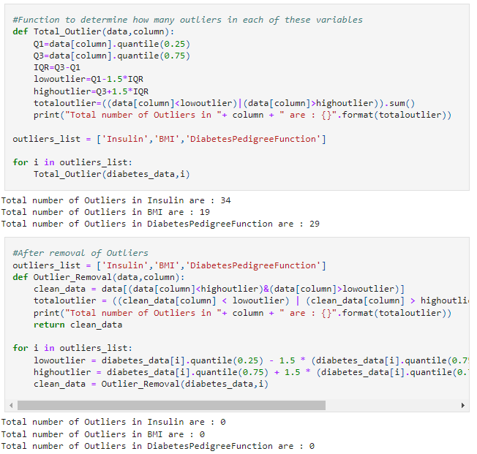
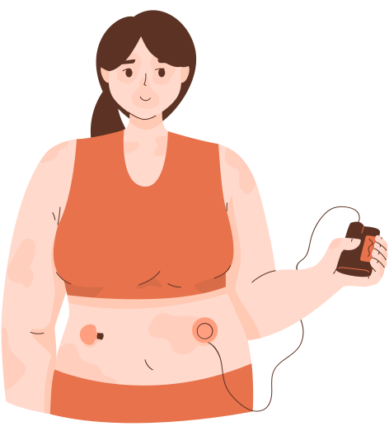
CURATION OF DATA
‘Insulin’, ‘BMI’ and ‘DiabetesPedigreeFunction’ all have large amounts of Outliers
To reduce inaccuracies, IQR formula was used to remove them

Slide 14
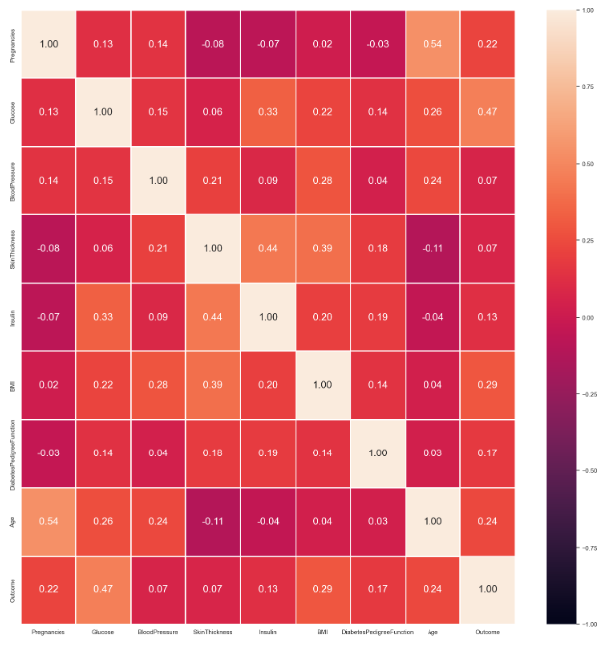
CORRELATION OF THE DATA
Correlation of each variable to the ‘Outcome’
Outcome has higher positive correlations to the variables, Glucose, BMI and Age.
Correlation coefficient is 0.47, 0.29 and 0.24 respectively

Slide 15
MACHINE LEARNING
& MODEL TRAINING

Slide 16

PREPARATION
TO TRAIN THE MODELS
65-35 Train Test Split
Needed a model that is good at handling numerical data in order to classify
Most ML model used are mainly of classification as outcome is either ‘1’ or ‘0’, meaning whether a patient has diabetes or not.
Models used :
Decision Tree
Logistic Regression
Gaussian Naive Bayes
K-Means

Slide 17
DECISION TREE

Slide 18
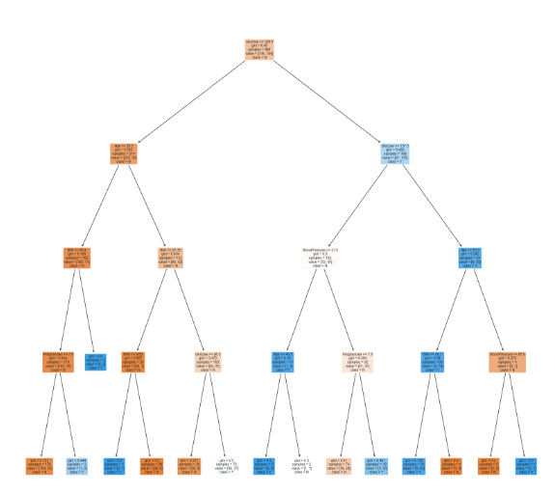
DECISION TREE
A hierarchical, tree structure, which consists of a root node, branches, internal nodes and leaf nodes.
Predicts class or value by learning simple decision rules
Employs a divide and conquer strategy to identify the optimal split points
Gini Index, Entropy Criterion - popular splitting criterion to choose the best attribute at each node

Slide 19
LOGISTIC REGRSSION

Slide 20
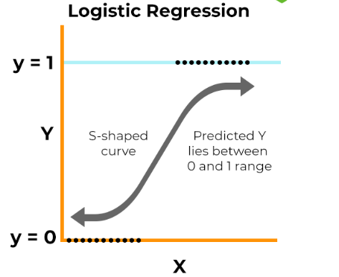
LOGISTIC REGRESSION
Estimates the probability of an event occurring, based on a given data set of independent variables.
Most variables should be independent to one another/ does not have a strong correlation.
Uses the following formulas:
Logit(pi) = 1/(1+ exp(-pi))
ln(pi/(1-pi)) = Beta_0 + Beta_1*X_1 + … + B_k*K_k
Logistic regression seeks to find the best parameter estimate.

Slide 21
GAUSSIAN NAIVE BAYES (GNB)
Notes:
Simple
Efficient
Works with smaller datasets

Slide 22
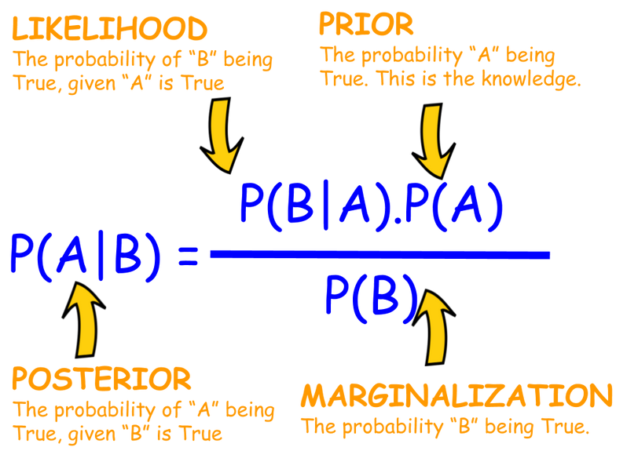
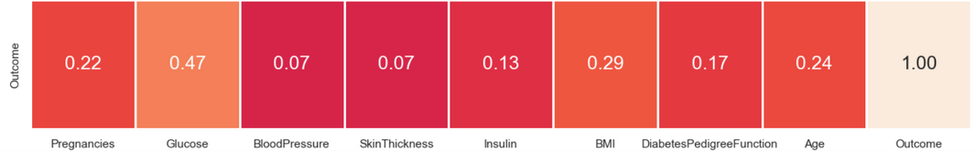
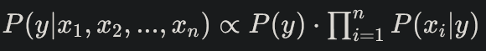
HOW GNB WORKS
GNB classification works based on the Bayes’ Theorem to calculate posterior probability of classes diabetes positive and diabetes negative given features of the dataset
GNB assumes that features are “independent”, meaning low correlation for most features.
During model training, GNB calculates the prior probability of each class and likelihood for each feature given each class
For prediction of a new instance, GNB calculates the posterior probability of each class using the formula below by using the features from the new instance, scaled by the product of the prior probability of the class multiplied by the likelihood of features given the class from the training phase.
The posterior probability of both classes will then add up to one. Whichever class’ probability is higher is considered the prediction.

Slide 23
K-MEANS

Slide 24
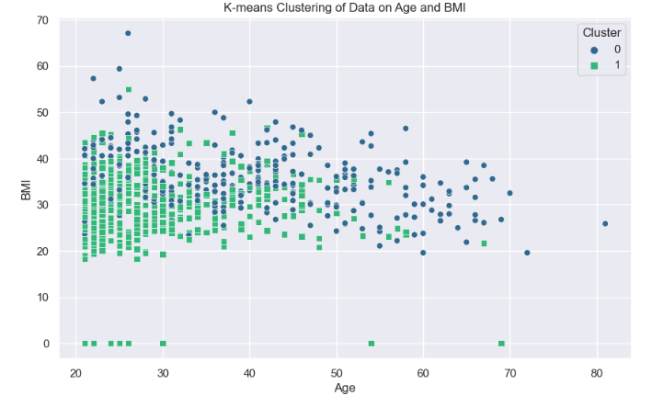
K-MEANS CLUSTERING OF DATA ON AGE AND BMI

Slide 25
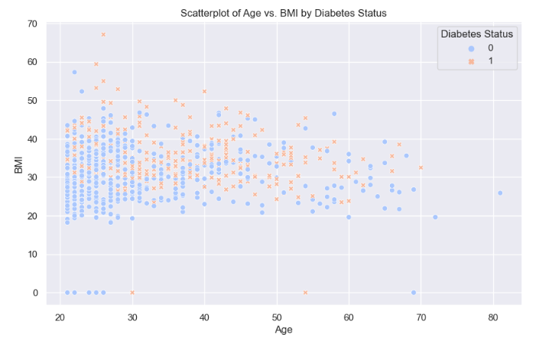
SCATTERPLOT OF DATA ON AGE AND BMI

Slide 26
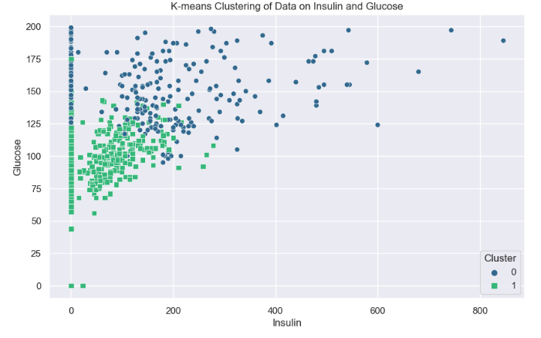
K-MEANS CLUSTERING OF DATA ON INSULIN AND GLUCOSE

Slide 27
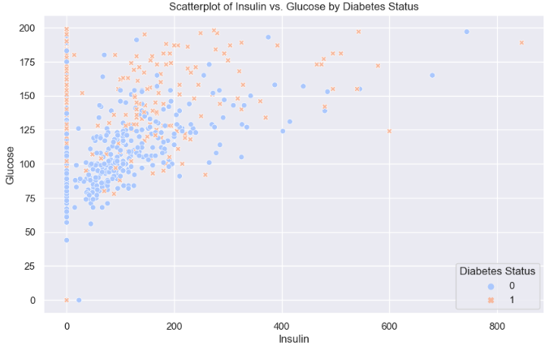
SCATTERPLOT OF DATA ON INSULIN AND GLUCOSE

Slide 28
HOW K-MEANS WORK
Initialization Randomly select K initial centroids.
Assignment Assign each point to the closest centroid.
Update Calculate the mean of all points in each cluster to find new centroids.
Iteration Reassign each point based on the new centroids and recalculate centroids
Output The final centroids and cluster assignments of the points.

Slide 29
K-MEANS ANALYSE
K =2 to represent having diabetes or not
Cluster 0 means have diabetes, Cluster 1 means no diabetes
BMI of more than 25 to 30 is more likely to have diabetes. Age on the other hand, for those that have diabetes can range from 20 to 70
Glucose of more than 125 and Insulin of lower than 200 to 350 have a higher chance of having diabetes. Based on the K-Means clustering, group 0 is more likely to have diabetes.

Slide 30
CONCLUSION

Slide 31


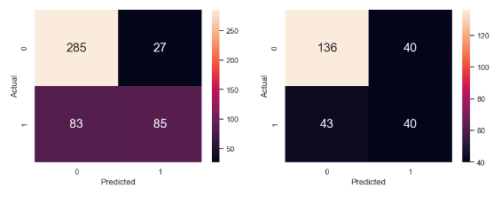
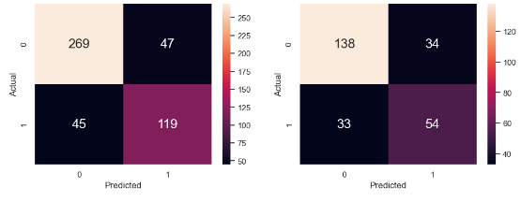
HOW MANY VARIABLES SHOULD BE USED?
Based on the Goodness Fit models :
The first decision tree model used only a single variable, Glucose, that has the highest correlation to Outcome
Rate for False Negatives is quite high, hence rendering the prediction model using only a single variable very inaccurate.
By using all the variables, can see a big improvement in accuracy
Hence, using all attributes given that are related is the most optimal choice
Decision Tree using a Single Variable (Glucose)
Decision Tree using All Variables

Slide 32
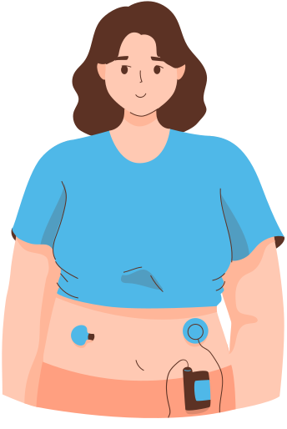
MODEL PERFORMANCE
Model | Area Under Curve (ROC Curve) | Classification Accuracy (Test set)
Decision Tree | 0.71 | 68%
Logistic Regression | 0.73 | 78%
Gaussian naive bayes | 0.86 | 79%
K-Means | X | Not very accurate (only acts as a guideline)

Slide 33
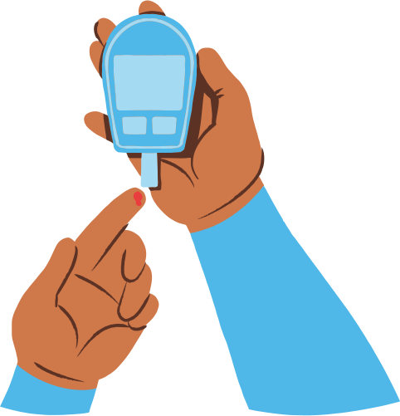
OUTCOME
In conclusion, it is better to use all the variables given, which are ‘Glucose’, ‘BloodPressure’, ‘SkinThickness’, ‘Insulin’, ‘BMI’, ‘DiabetesPedigreeFunction’, ‘Pregnancies’ & ‘Age’
Most Efficient Model = Gaussian Naive Bayes Model

Slide 34
CONCLUDING INSIGHTS
Recommend the medical field in using the most accurate model within our code to predict diabetes, which is the Gaussian Model
Acknowledging Limitations :
Small data size, only below 800 entries
May not be accurate on males (pregnancy was taken into consideration)
Data predicted may need to be taken with a pinch of salt, as it is not fully accurate.
With this predictor in mind, we hope to be able to help people in detecting diabetes early in hopes to reverse the condition.

Slide 35
THANK
YOU!

Slide 36
References
https://towardsdatascience.com/bayes-rule-with-a-simple-and-practical-example-2bce3d0f4ad0
https://www.kaggle.com/datasets/kandij/diabetes-dataset
https://www.ncbi.nlm.nih.gov/pmc/articles/PMC7700832/#:~:text=2.,or%20leisure%20facilities%20%5B1%5D.
https://www.singhealth.com.sg/patient-care/conditions-treatments/Type-2-diabetes-mellitus#:~:text=Being%20overweight%20or%20obese,pressure%20(above%20140%2F90mmHg)
https://diabetesatlas.org/#:~:text=Diabetes%20around%20the%20world%20in%202021%3A,%2D%20and%20middle%2Dincome%20countries.
https://www.ncbi.nlm.nih.gov/pmc/articles/PMC9324493/#:~:text=The%20early%20detection%20of%20diabetes,prediction%2C%20categorization%2C%20and%20treatment.

